Slide 1
Snowflake - Architecture
SAAS Offering on Cloud
No maintenance & administrative overhead costs
Snowflake separates its architecture into the below 3 layers :
Cloud Services
Compute Services
Database Storage
Snowflake architecture is a hybrid of “Shared Disk Database” and “Shared Nothing Database”

Slide 2
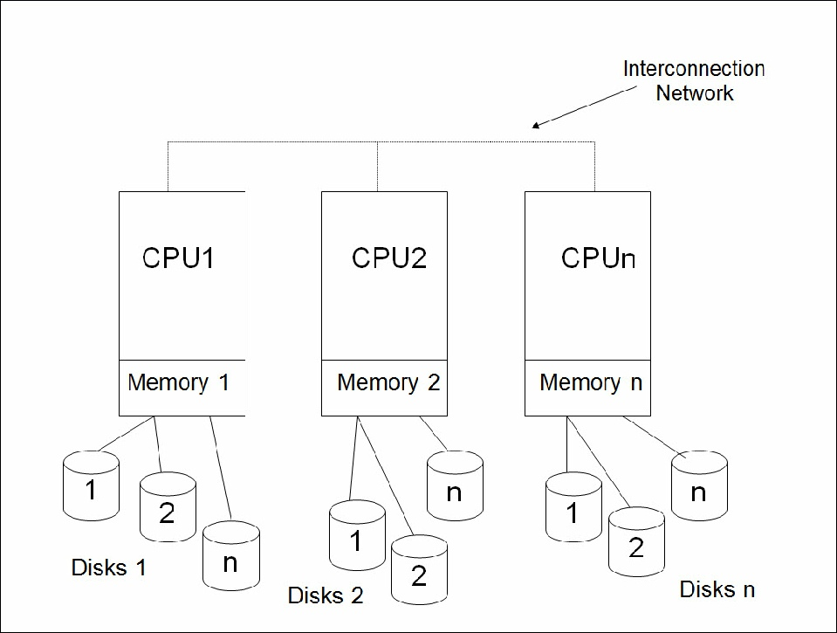
Shared Nothing Architecture

Slide 3
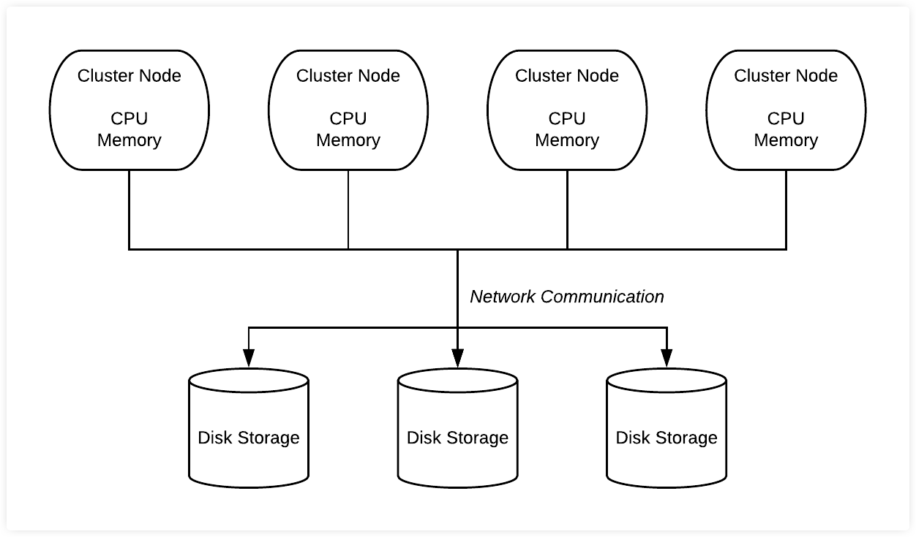
Shared Disk Architecture

Slide 4
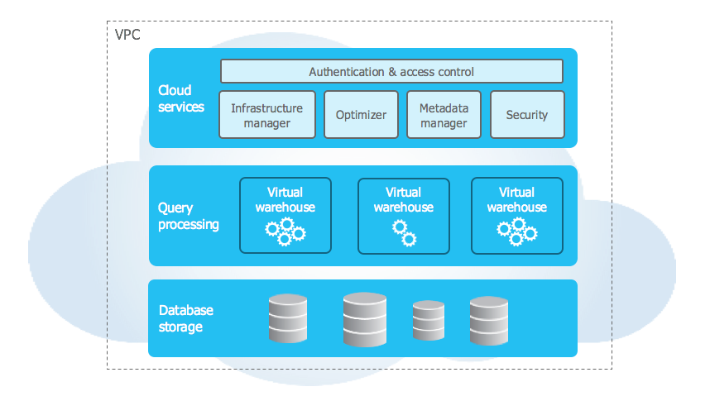
Snowflake - Architecture & Layers

